Slide 1
Operators in C++
An operator is a symbol that tells the compiler to perform specific mathematical or logical manipulations. C++ is rich in built-in operators and provide the following types of operators
Arithmetic Operators +,/,*,-,%,
Relational Operators
Logical Operators
Bitwise Operators
Assignment Operators
Misc Operators

Slide 2
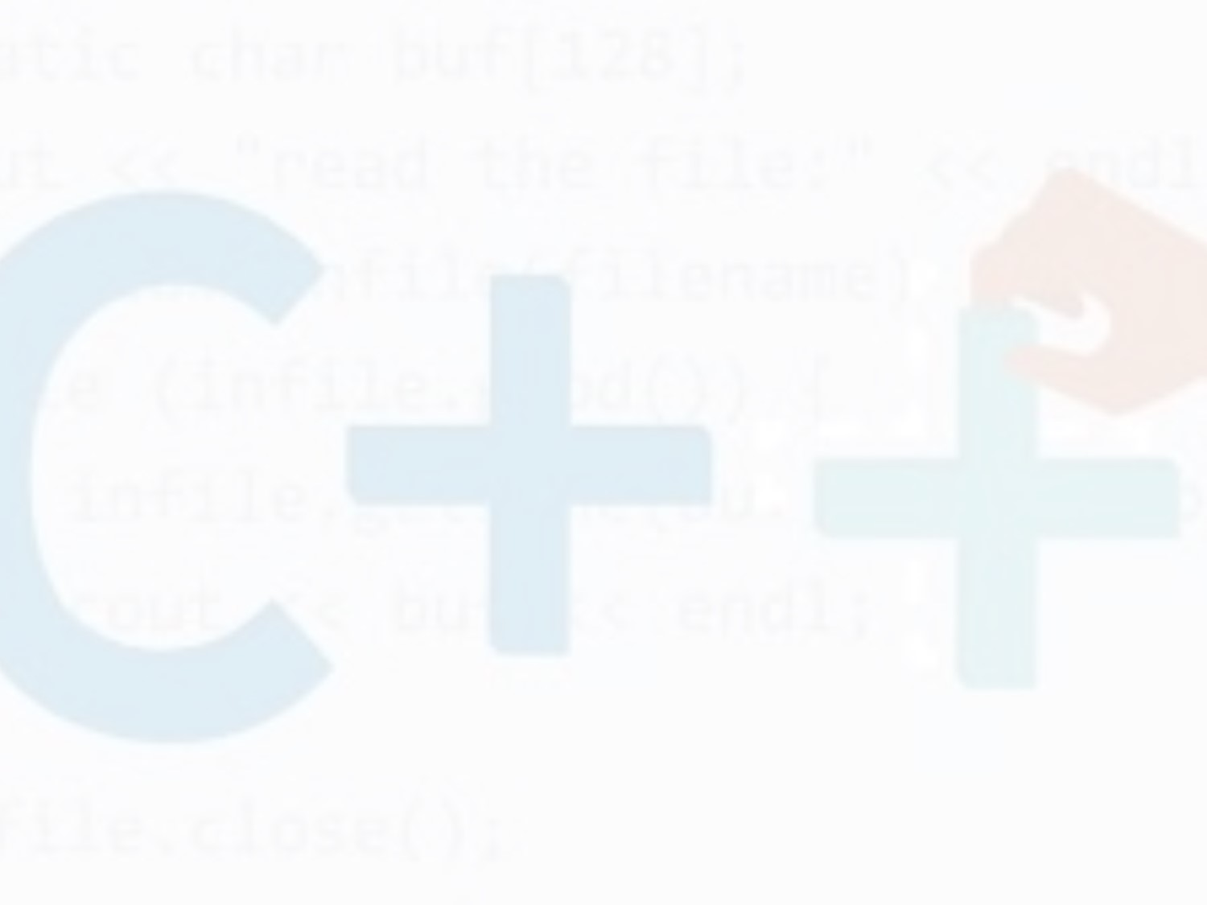
Assignment Operator
An operator to give (assign) a value to a variable.
Denote as ‘=‘
Only variable can be on the left side.
An expression is on the right side.
Variables keep their assigned values until changed by another assignment statement or by reading in a new value.

Slide 3
Assignment Operator Syntax
Variable = Expression
  First, expression on right is evaluated.
  Then the resulting value is stored in the memory location of Variable on left.
NOTE: An automatic type coercion occurs after evaluation but before the value is stored if the types differ for Expression and Variable

Slide 4
Assignment Operator Mechanism
Example:
  int count = 0;
  int starting;
  starting = count + 5;
Expression evaluation:
  Get value of count: 0
  Add 5 to it.
  Assign to starting
0
12345 (garbage)
5

Slide 5
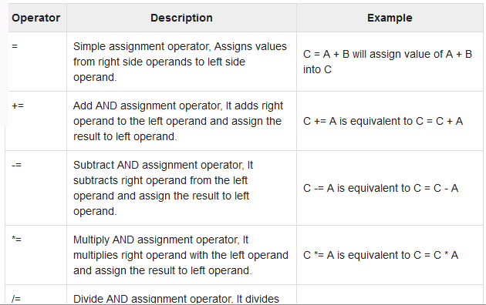
Assignment Operators

Slide 6
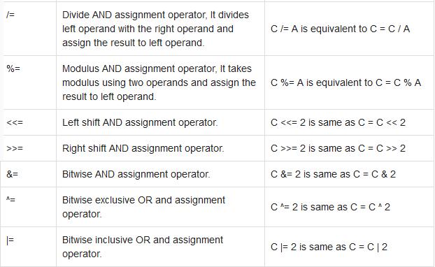

Slide 7
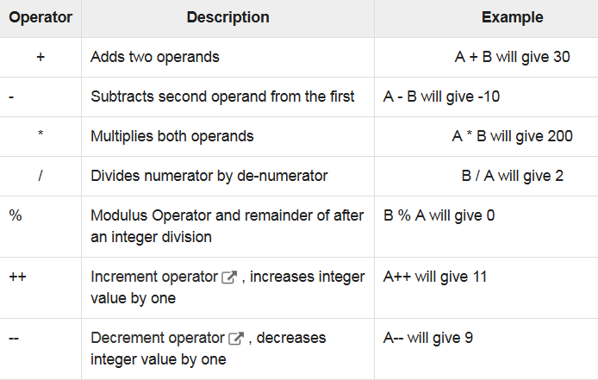
Arithmetic Operators
There are following arithmetic operators supported by C++ language: Assume variable A holds 10 and variable B holds 20, then

Slide 8
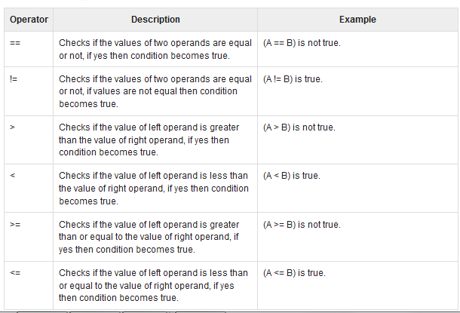
Relational Operators
There are following relational operators supported by C++ language
Assume variable A holds 10 and variable B holds 20, then:

Slide 9
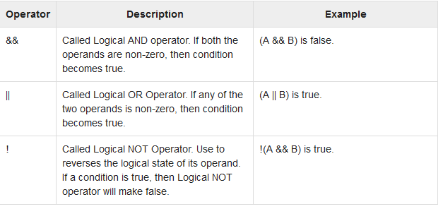
Logical Operators
There are following logical operators supported by C++ language.
Assume variable A holds 1 and variable B holds 0, then:

Slide 10
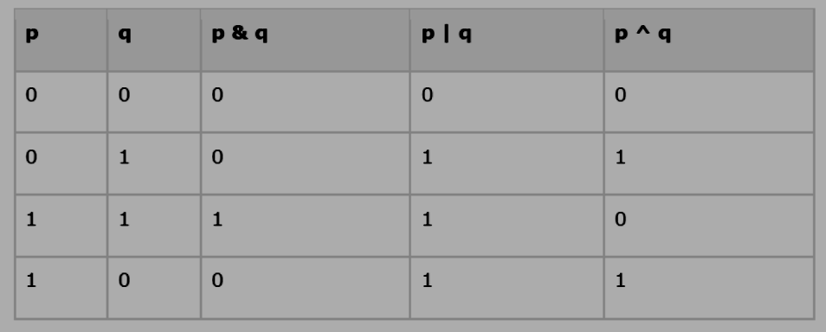
Bitwise Operators
Bitwise operator works on bits and perform bit-by-bit operation. The truth tables for &, |, and ^ are as follows:
Assume if A = 60; and B = 13; now in binary format they will be as follows:
A = 0011 1100
B = 0000 1101
-----------------
A&B = 0000 1100
A|B = 0011 1101
A^B = 0011 0001
~A = 1100 0011

Slide 11
Operators Precedence in C++
Operator precedence determines the grouping of terms in an expression. This affects how an expression is evaluated. Certain operators have higher precedence than others; for example, the multiplication operator has higher precedence than the addition operator −
For example x = 7 + 3 * 2; here, x is assigned 13, not 20 because operator * has higher precedence than +, so it first gets multiplied with 3*2 and then adds into 7.
Here, operators with the highest precedence appear at the top of the table, those with the lowest appear at the bottom. Within an expression, higher precedence operators will be evaluated first.

Slide 12
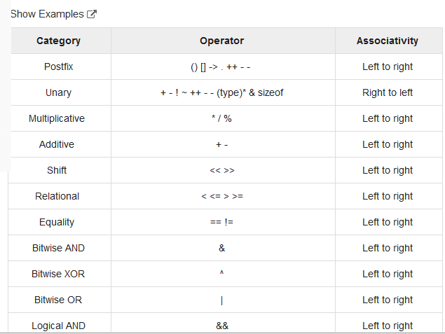
Operator precedence

Slide 13
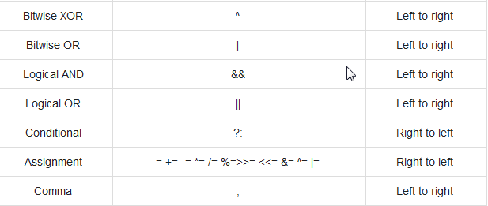

Slide 14
Keyboard and Screen I/O
#include <iostream>
input data
output data
executing
program
Keyboard
Screen
cin
(of type istream)
cout
(of type ostream)

Slide 15
Insertion Operator ( << )
Variable cout is predefined to denote an output stream that goes to the standard output device (display screen).
The insertion operator << called “put to” takes 2 operands.
The left operand is a stream expression, such as cout. The right operand is an expression of simple type or a string constant.

Slide 16
Output Statements
SYNTAX
cout statements can be linked together using << operator.
These examples yield the same output:
cout << “The answer is “ ;
cout << 3 * 4 ;
cout << “The answer is “ << 3 * 4 ;
cout << Expression << Expression . . . ;

Slide 17
Output Statements (String constant)
String constants (in double quotes) are to be printed as is, without the quotes.
  cout<<“Enter the number of candy bars ”;
  OUTPUT: Enter the number of candy bars
“Enter the number of candy bars ” is called a prompt.
All user inputs must be preceded by a prompt to tell the user what is expected.
You must insert spaces inside the quotes if you want them in the output.
Do not put a string in quotes on multiple lines.

Slide 18
Output Statements (Expression)
All expressions are computed and then outputted.
  cout << “The answer is ” << 3 * 4 ;
  OUTPUT: The answer is 12

Slide 19
Escape Sequences
The backslash is called the escape character.
It tells the compiler that the next character is “escaping” it’s typical definition and is using its secondary definition.
Examples:
  new line: \n
  horizontal tab: \t
  backslash: \\
  double quote \”

Slide 20
Newline
cout<<“\n” and cout<<endl both are used to insert a blank line.
Advances the cursor to the start of the next line rather than to the next space.
Always end the output of all programs with this statement.

Slide 21
Extraction Operator (>>)
Variable cin is predefined to denote an input stream from the standard input device (the keyboard)
The extraction operator >> called “get from” takes 2 operands. The left operand is a stream expression, such as cin--the right operand is a variable of simple type.
Operator >> attempts to extract the next item from the input stream and store its value in the right operand variable.

Slide 22
Input Statements
SYNTAX
cin statements can be linked together using >> operator.
These examples yield the same output:
cin >> x;
cin >> y;
cin >> x >> y;
cin >> Variable >> Variable . . . ;

Slide 23
How Extraction Operator works?
Input is not entered until user presses <ENTER> key.
Allows backspacing to correct.
Skips whitespaces (space, tabs, etc.)
Multiple inputs are stored in the order entered:
    cin>>num1>>num2;
    User inputs: 3 4
    Assigns num1 = 3 and num2 = 4

Slide 24
Arithmetic Operators
Operators: +, -, * /
For floating numbers, the result as same as Math operations.
Note on integer division: the result is an integer. 7/2 is 3.
% (remainder or modulo) is the special operator just for integer. It yields an integer as the result. 7%2 is 1.
Both / and % can only be used for positive integers.
Precedence rule is similar to Math.

Slide 25
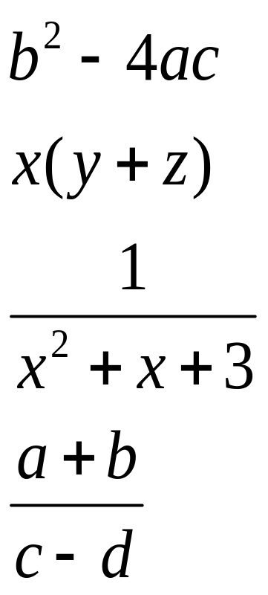
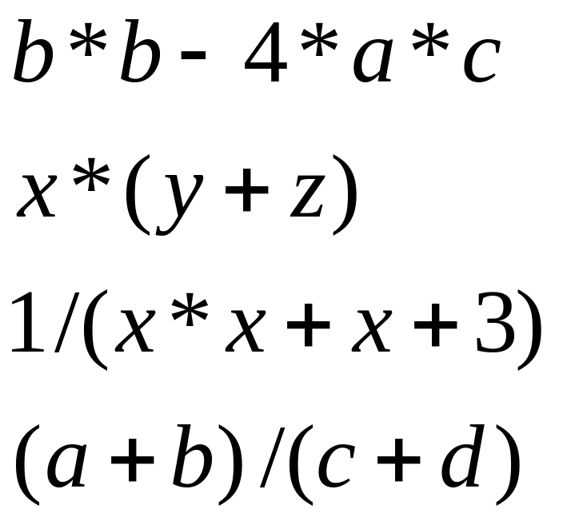
Arithmetic Expressions
Arithmetic operations can be used to express the mathematic expression in C++:

Slide 26
bool Data Type
Type bool is a built-in type consisting of just 2 values, the constants true and false
We can declare variables of type bool
  bool hasFever; // true if has high temperature
  bool isSenior; // true if age is at least 55
The value 0 represents false
ANY non-zero value represents true

Slide 27
Boolean Expression
Expression that yields bool result
Include:
  6 Relational Operators
  < <= > >= == !=
  3 Logical Operators
  ! && ||

Slide 28
Relational Operators
are used in boolean expressions of form:
ExpressionA Operator ExpressionB
  temperature > humidity
  B * B - 4.0 * A * C > 0.0
  abs (number) == 35
  initial != ‘Q’
Notes:
  == (equivalency) is NOT = (assignment)
  characters are compared alphabetically. However, lowercase letters are higher ASCII value.
  An integer variable can be assigned the result of a logical expression
  You cannot string inequalities together:
      Bad Code: 4<x<6 Good Code: (x > 4) &&(x < 6)

Slide 29
Relational Operators
int x, y ;
x = 4;
y = 6;
EXPRESSION VALUE
x < y true
x + 2 < y false
x != y true
x + 3 >= y true
y == x false
y == x+2 true
y = x + 3 7
y = x < 3 0
y = x > 3 1

Slide 30
Logical Operators
are used in boolean expressions of form:
ExpressionA Operator ExpressionB
A || B (true if either A or B or both are true. It is false otherwise)
A && B (true if both A and B are true. It is false otherwise)
!A (true if A is false. It is false if A is true)
Notes:
Highest precedence for NOT, AND and OR are low precedence.
Associate left to right with low precedence. Use parenthesis to override priority or for clarification
  x && y || z will evaluate “x && y ” first
  x && (y || z) will evaluate “y || z” first

Slide 31
Logical Operators
int age ;
bool isSenior, hasFever ;
float temperature ;
age = 20;
temperature = 102.0 ;
isSenior = (age >= 55) ; // isSenior is false
hasFever = (temperature > 98.6) ; // hasFever is true
EXPRESSION VALUE
isSenior && hasFever false
isSenior || hasFever true
!isSenior true
!hasFever false

Slide 32
Precedence Chart
++, --, !, - (unary minus), + (unary plus)
*, /, %
+ (addition), - (subtraction)
<<, >>
<, <=, >, >=
==, !=
&&
||
=
Highest
Lowest

Slide 33
Boolean Expression (examples)
taxRate is over 25% and income is less than $20000 (taxRate > .25) && (income < 20000)
temperature is less than or equal to 75 or humidity is less than 70% (temperature <= 75) || (humidity < .70)
age is between 21 and 60 (age >= 21) && (age <= 60)
age is 21 or 22 (age == 21) || (age == 22)

Slide 34
Pre-increment and Post-increment in C/C++
Pre-increment operator: A pre-increment operator is used to increment the value of a variable before using it in a expression. In the Pre-Increment, value is first incremented and then used inside the expression.
Syntax: a = ++x;
Here, if the value of ‘x’ is 10 then value of ‘a’ will be 11 because the value of ‘x’ gets modified before using it in the expression.

Slide 35
CPP program to demonstrate pre increment // operator. #include <iostream> using namespace std; int main() { int x = 10, a; a = ++x; cout << "Pre Increment Operation"; // Value of a will change cout << "\na = " << a; // Value of x change before execution of a=++x; cout << "\nx = " << x; return 0; }

Slide 36
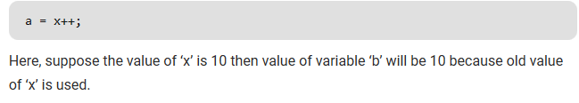
Post-increment operator:
A post-increment operator is used to increment the value of variable after executing expression completely in which post increment is used. In the Post-Increment, value is first used in a expression and then incremented
Syntax:

Slide 37
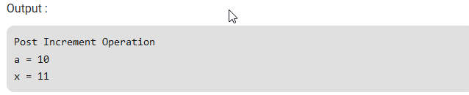
Here, suppose the value of ‘x’ is 10 then value of variable ‘b’ will be 10 because old value of ‘x’ is used. // CPP program to demonstrate pre increment // operator. #include <iostream> using namespace std; int main() { int x = 10, a; a = x++; cout << "Post Increment Operation"; // Value of a will not change cout << "\na = " << a; // Value of x change after execution of a=x++; cout << "\nx = " << x; return 0; }

Slide 38
Evaluating post and pre-increment together
Precedence of postfix ++ is more than prefix ++ and their associativity is also different. Associativity of prefix ++ is right to left and associativity of postfix ++ is left to right.
  Associativity of postfix ++ is left to right
  Associativity of prefix ++ is right to left

